Slide 2
Learning Objectives (1 of 2)
Define a computer system, and describe its components
Discuss the history of computer hardware and software
Explain the factors distinguishing the computing power of computers
Summarize computer operations
Discuss the types of input, output, and memory devices

Slide 3
Learning Objectives (2 of 2)
Explain how computers are classified
Describe the two major types of software
List the generations of computer languages

Slide 4
Defining a Computer (1 of 3)
A computer is a machine that:
Accepts data as input
Processes data without human intervention using stored instructions
Outputs information
Instructions (i.e., program) are:
Step-by-step directions for performing a specific task
Written in a language the computer can understand

Slide 5
Defining a Computer (2 of 3)
Garbage in, garbage out (GIGO)
If input data is erroneous, the information provided by the computer is also erroneous

Slide 6
Defining a Computer (3 of 3)
Writing a computer program
Identify what needs to be done
Plan a method to achieve the goal
Select the right language
Depends on the problem being solved and the type of computer being used
A program is also called a source code
Must be translated into object code, consisting of binary 0s and 1s

Slide 7
Components of a Computer System (1 of 5)
Hardware components
Physical devices such as keyboards, monitors, and processing units
Software components
Programs written in computer languages

Slide 8
Components of a Computer System (2 of 5)
Central processing unit (CPU): heart of a computer
Arithmetic logic unit (ALU): performs arithmetic operations (+, –, *, /) and comparison or relational operations (<, >, =)
Control unit: tells the computer what to do, such as instructing the computer which device to read or send output to

Slide 9
Components of a Computer System (3 of 5)
Computers can either have a single processor or multiprocessors
Multiprocessing: use of two or more CPUs in a single computer system

Slide 10
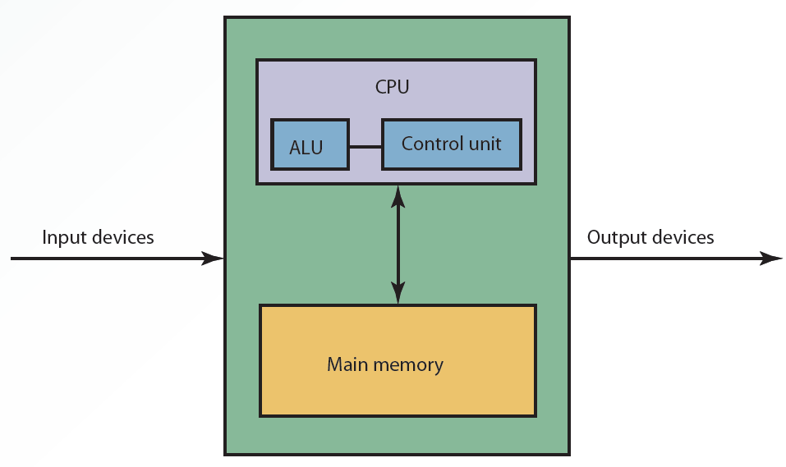
2.1 The Building Blocks of a Computer

Slide 11
Components of a Computer System (4 of 5)
Bus: link between devices connected to the computer
Parallel or serial
Internal (local) or external
Disk drive: peripheral device for recording, storing, and retrieving information

Slide 12
Components of a Computer System (5 of 5)
CPU case: enclosure containing the computer’s main components
Referred to as computer chassis or tower
Motherboard: main circuit board containing connectors for attaching additional boards

Slide 13
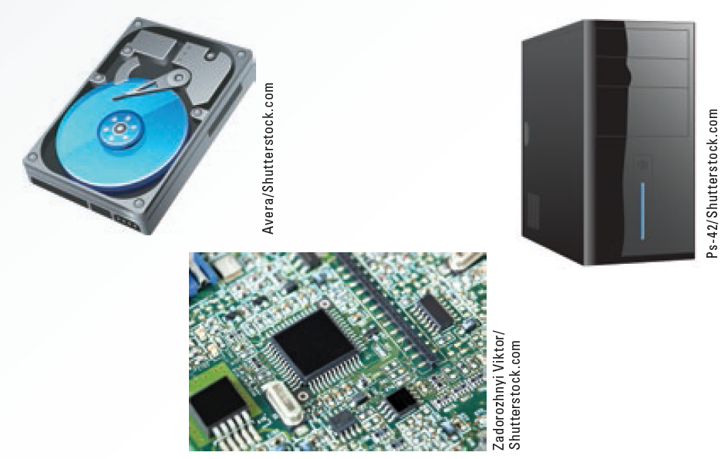
2.2 Components of a Computer System

Slide 14
The History of Computer Hardware and Software
Major developments in hardware have taken place over the past 60 years
To make these developments more clear, computers are often categorized into “generations”

Slide 15
2.1 Hardware Generations
Generation | Date | Major Technologies | Example
First | 1946–1956 | Vacuum tube | ENIAC
Second | 1957–1963 | Transistors | IBM 7094, 1401
Third | 1964–1970 | Integrated circuits, remote data entry, telecommunications | IBM 360, 370
Fourth | 1971–1992 | Miniaturization, VSLI, personal computers, optical disks | Cray XMP, Cray II
Fifth | 1993–present | Parallel processing, gallium arsenide chips, optical technologies | IBM System zEnterprise EC12

Slide 16
The Power of Computers
Computers draw their power from three factors that far exceed human capacities
Speed
Accuracy
Storage and retrieval capabilities

Slide 17
Speed
Computer speed is measured as the number of instructions performed per fractions of a second
Millisecond: 1/1,000 of a second
Microsecond:1/1,000,000 of a second
Nanosecond:1/1,000,000,000 of a second
Picosecond:1/1,000,000,000,000 of a second

Slide 18
Accuracy
Degree of accuracy is critical in many computer applications
A small degree of inaccuracy could lead the space shuttle to land in Canada instead of the United States

Slide 19
Storage and Retrieval
Storage: saving data in computer memory
Retrieval: accessing data from memory
Data is stored in bits
American Standard Code for Information Interchange (ASCII)
Data code for text files, PC applications, and the Internet
Defines up to 128 characters

Slide 20
2.3 Storage Measurements (Approx.)
Value | Size in Bytes
1 bit | A single value of 0 or 1
8 bits | 1 byte or character
2¹⁰ bytes | 1,000 bytes, or 1 kilobyte (KB)
2²⁰ bytes | 1,000,000 bytes, or 1 megabyte (MB)
2³⁰ bytes | 1,000,000,000 bytes, or 1 gigabyte (GB)
2⁴⁰ bytes | 1,000,000,000,000 bytes, or 1 terabyte (TB)
2⁵⁰ bytes | 1,000,000,000,000,000 bytes, or 1 petabyte (PB)
2⁶⁰ bytes | 1,000,000,000,000,000,000 bytes, or 1 exabyte (EB)

Slide 21
Computer Operations
Computer functions
Three basic tasks: arithmetic operations, logical operations, and storage and retrieval operations
Add, subtract, multiply, divide, and raise numbers to a power (exponentiation)
Perform comparison operations by comparing two numbers
Store massive amounts of data in very small spaces and locate a particular item quickly

Slide 22
Input, Output, and Memory Devices
To use a computer and process data, three major components are needed
Input
Output
Memory

Slide 23
Input Devices
Send data and information to the computer
Keyboard, mouse, touch screen, light pen, trackball, data tablet, barcode reader, optical character reader (OCR), magnetic ink character recognition (MICR) system, and optical mark recognition (OMR) system

Slide 24
Output Devices
Many output devices are available for both mainframes and personal computers
Display output in the forms of soft copy and hard copy
Plotters convert output to graphics
Voice synthesizers convert output to voice

Slide 25
Memory Devices
Main memory
Stores data and information and is volatile
Contents are lost when electrical power is turned off
Secondary memory
Nonvolatile; holds data when the computer is off or during course of a program's operation
Serves as archival storage

Slide 26
Main Memory Devices (1 of 2)
Semiconductor chips made of silicon
Can be volatile or nonvolatile
Random access memory (RAM)
Volatile memory, in which data can be read from and written to
Known as read-write memory
Cache RAM: stores recently accessed memory
Resides on the processor

Slide 27
Main Memory Devices (2 of 2)
Read-only memory (ROM)
Nonvolatile
Data cannot be written to it
Includes BIOS information and the computer system’s clock
Other types of ROM
Programmable read-only memory (PROM)
Erasable programmable read-only memory (EPROM)

Slide 28
Secondary Memory Devices (1 of 2)
Magnetic disks
Made of Mylar or metal
Used for random-access processing
Magnetic tape
Made of a plastic material
Stores data sequentially
Optical discs
Use laser beams to access and store data
CD-ROMs, WORM discs, and DVDs

Slide 29
Secondary Memory Devices (2 of 2)
Other devices include hard disks, USB flash drives, and memory cards
Redundant array of independent disks (RAID) system
Collection of disk drives used for fault tolerance and improved performance
Found in large network systems
Cloud storage
Involves multiple virtual servers that are hosted by third parties

Slide 30
2.4 Capacity of Secondary Memory Devices
Device | Storage Capacity
Memory stick | 1 TB
Hard disk | 16 TB
CD-ROM, CD-R, CD-RW | 800 MB
DVD-ROM, DVD-R, DVD-RW | 4.7 GB or more
Blu-Ray (latest generation optical disc) | Up to 25 GB on a single-layer disc and 50 GB on a dual-layer disc
SD Card | 1 TB
SSD | 60 TB

Slide 31
Storage Area Networks and Network-Attached Storage
Storage area network (SAN)
Dedicated high-speed network consisting of both hardware and software
Connect and manage shared storage devices
Disk arrays, tape libraries, and optical storage devices
Network-attached storage (NAS)
Network-connected computer dedicated to provide file-based data storage services to other network devices

Slide 32
Classes of Computers
Based on cost, amount of memory, speed, and sophistication
Computer classifications
Subnotebooks and notebooks
Personal and minicomputers
Mainframes
Supercomputers

Slide 33
Server Platforms: An Overview
Server: computer and all the software for managing network resources and offering services to a network
Available server platforms: application servers, database servers, disk servers, fax servers, file servers, mail servers, print servers, remote access servers (RAS), and Web servers

Slide 34
What is Software?
Programs that run a computer system
Classifications
System software: works in the background and takes care of tasks, such as deleting waste files
Application software: performs specialized tasks

Slide 35
Operating System Software (1 of 2)
Set of programs for controlling and managing computer hardware and software
Provides an interface between a computer and the user
Increases computer efficiency by helping users share computer resources and performing repetitive tasks for users

Slide 36
Operating System Software (2 of 2)
Consists of control programs to manage hardware and resources by performing:
Job management
Resource allocation
Data management
Communication
Supervisor program (i.e., the kernel)
Responsible for controlling all other programs in the OS

Slide 37
Application Software
Commercial software or software developed in house; used to perform variety of tasks on a personal computer
Word processing, spreadsheet, database, presentation, and graphics
Desktop publishing
Financial planning and accounting
Project management
Computer-aided design (CAD)

Slide 38
Computer Languages (1 of 4)
Machine language
First generation of computer languages
Consists of a series of 0s and 1s representing data or instructions
Dependent on the machine
Time-consuming to write a program

Slide 39
Computer Languages (2 of 4)
Assembly language
Second generation of computer languages
Machine dependent and a higher-level language than machine language
Uses a series of short codes, or mnemonics, to represent data or instructions

Slide 40
Computer Languages (3 of 4)
High-level languages
Third-generation of computer languages
Machine independent and self-documenting
Used for Web development and Internet applications
Fourth-generation languages (4GLs)
Commands are powerful and easy to learn
Use macro codes that can take the place of several lines of programming

Slide 41
Computer Languages (4 of 4)
Fifth-generation languages
Use artificial intelligence technologies
Knowledge-based systems, natural language processing (NLP), visual programming, and a graphical approach to programming
Designed to facilitate natural conversations between an individual and the computer

Slide 42
Summary (1 of 2)
A computer can have many definitions
Major developments in hardware have taken place over the past 60 years
Computers draw their power from speed, accuracy, and storage and retrieval capabilities
Computers perform arithmetic, logical, and storage and retrieval operations

Slide 43
Summary (2 of 2)
Computers are classified based on cost, amount of speed, and sophistication
To process data, a computer requires input, output, and memory devices
Software is all the programs that run a computer system
Computer languages include machine, assembly, high-level, fourth- and fifth- generation languages

